Slide 1
Increase Our Faith
Luke 17:1-10

Slide 2
A Lesson in Forgiveness
Luke 17:1-4
The innocent must be willing to forgive the guilty party (verse 3)
As often as your brother asks, forgiveness must be extended (verse 4)
No finite number placed on forgiveness (verse 4)

Slide 3
The Request
This resonates with the apostles
They respond with a request, “Increase our faith” (verse 5)
Why does this prompt the request from the apostles?

Slide 4
Something Required
A willingness to …
Forgive (2 Timothy 4:16)
Be patient (Luke 17:4; Romans 12:12)
Put others’ needs above your own (Romans 12:20-21)
Deny ego

Slide 5
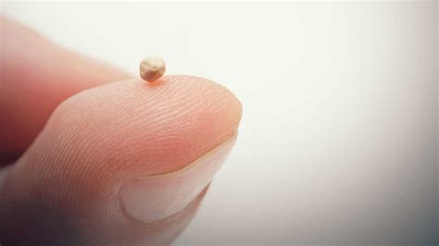
Faith as a Mustard Seed
Luke 17:6
Seed is about 1-2 millimeters in size

Slide 6
A Mustard Seed
Luke 17:6
With faith as a mustard seed one may move a sycamine tree
Not a promise of miracles
A little bit of the right stuff has powerful potential

Slide 7
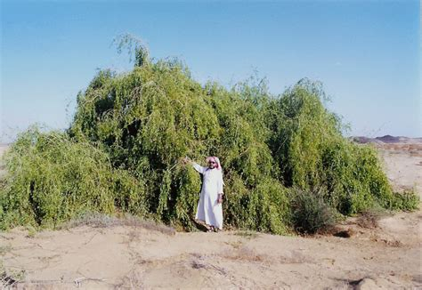
The Parable of the Mustard Seed
Matthew 13:31-32; Luke 13:18-19
Grew into a tree (Matthew 13:32)

Slide 8
The Parable of the Mustard Seed
Conclusion? Something small became something great
The potential of faith is great if it germinates

Slide 9
A Servant’s Duties
Luke 17:7-9
Does his master let him eat, or must he complete his tasks first? (verse 7)
”… serve me” (verse 8)
Does he thank his servant? (verse 9)
No
Why? Because he did his duty

Slide 10
Unprofitable Servants
Luke 17:10
When we have obeyed the commandments and say, “we are unprofitable servants,” we have done our duty
We will never be worthy in an absolute sense

Slide 11
Lessons Learned
Faith as a mustard seed
Faith is the beginning – Hebrews 11:1, 6
Faith must be cultivated – 2 Peter 1:5-8
God will work in our lives – 1 John 5:13-15
Must not doubt – James 1:5-8

Slide 12
Lessons Learned
Many Biblical Examples
Moses – A rod (Exodus 4:1-5, 17; 10:12ff)
Sampson – A bone (Judges 15:15)
Widow – Two mites (Mark 12:41ff)
Do we have faith as a mustard seed?

Slide 13
Lessons Learned
We must be doing our duty
Continue steadfastly – Acts 2:41-42
Attend worship – Hebrews 10:24-25
Study – Acts 17:11; 2 Timothy 2:15; 3:16-17
Visit fatherless and widows – James 1:27

Slide 14
Lessons Learned
We must be doing our duty
Always look for opportunity – Titus 2:14; 3:8, 14
Always abounding – 2 Corinthians 9:6-8

Slide 15
Conclusion
Do we have faith as a mustard seed?
Are we doing our duty?

